Slide 1

HOW A LEAP YEAR WORKS
TEJA TEPPALA

Slide 2

About me
Teja Teppala
Doctoral Candidate in Astronomy
Studies star formation in low-mass galaxies

Slide 3


Any leap day babies in the house?

Slide 4
Any leap day babies in the house?
Chances are about one in 1461!

Slide 5


What is a year, anyway?
This Photo by Unknown Author is licensed under CC BY-NC

Slide 6

Different definitions of a year

Slide 7
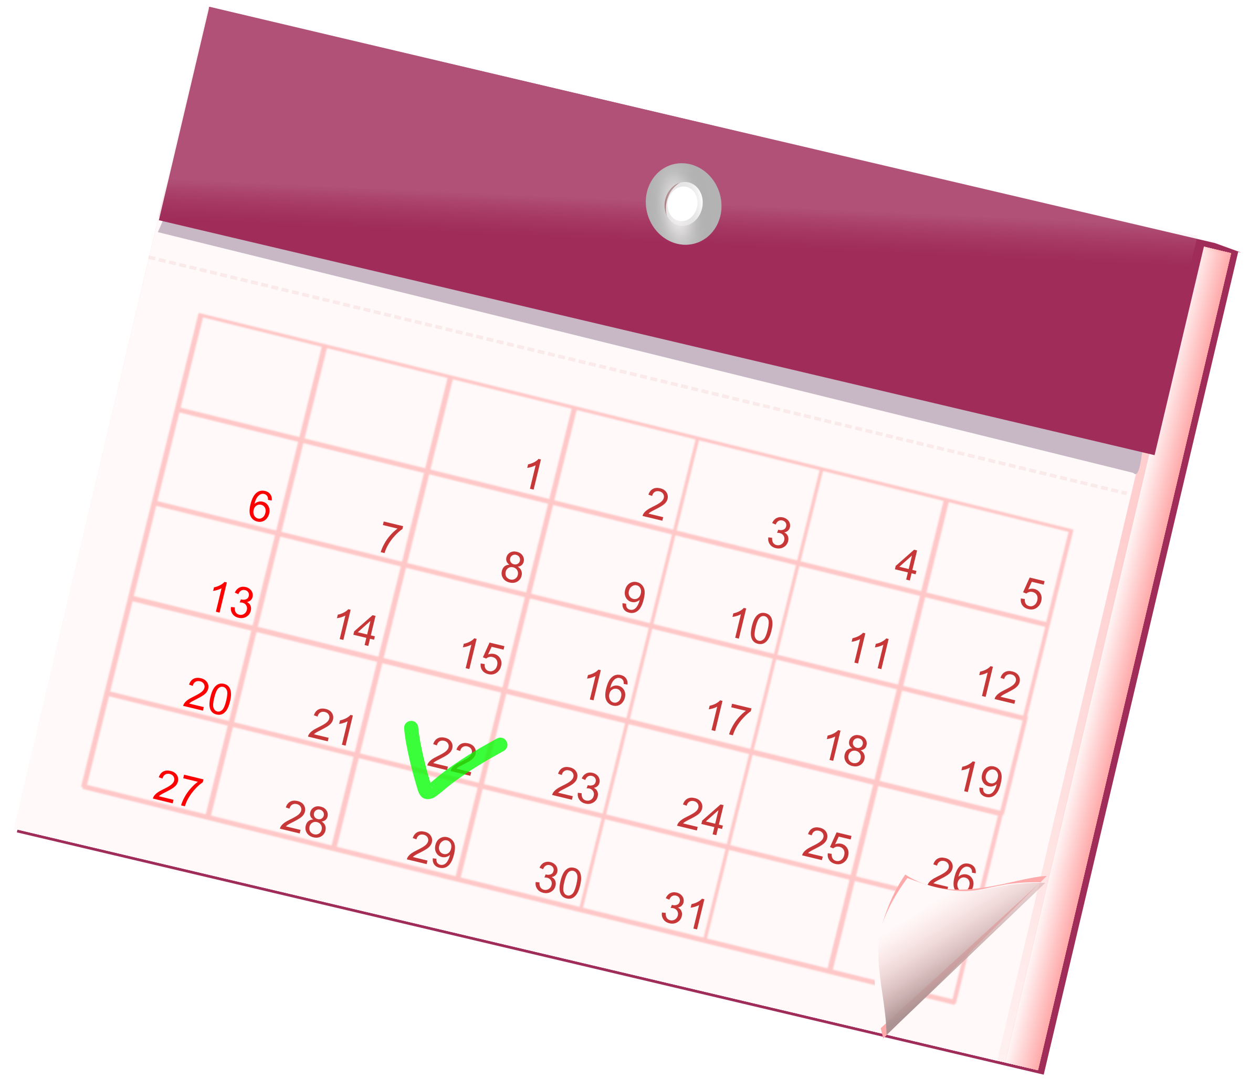
Different definitions of a year
Calendar year: 365 days (or 366 days in leap years)

Slide 8
Different definitions of a year

Slide 9
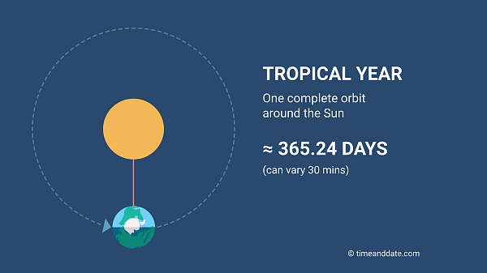
Different definitions of a year
Tropical year: time that the Sun takes to return to the same position in the sky.

Slide 10

Where’s this difference coming from?

Slide 11

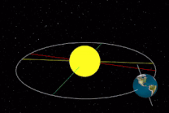
Where’s this difference coming from?
The day/night cycle due to Earth’s rotation, has nothing to do with the yearly cycle from Earth’s revolution.

Slide 12
Where’s this difference coming from?
The tropical year is actually 365 days, 5 hours, 48 minutes, and 46 seconds long, or 365.242199 days long.

Slide 13
Where’s this difference coming from?
The tropical year is actually 365 days, 5 hours, 48 minutes, and 46 seconds long, or 365.242199 days long.
TBH, a day isn’t exactly 24 hours long. But that’s a story for another time.

Slide 14

Before we dive in, why do we have seasons?

Slide 15

Reason for seasons:

Slide 16
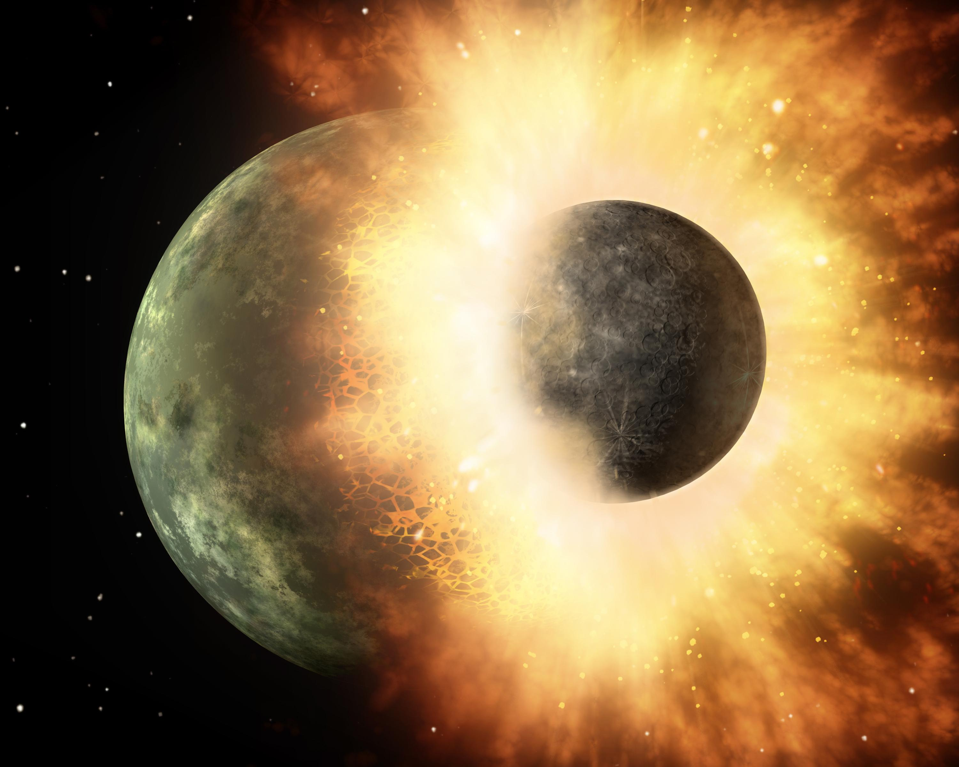
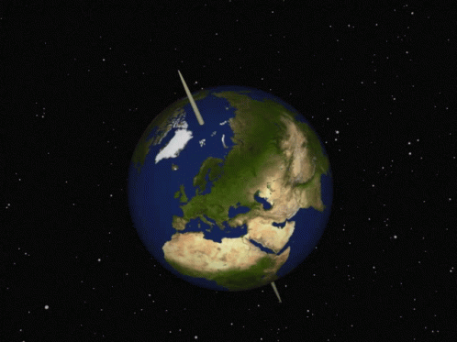
Reason for seasons:
Earth has seasons because something collided and caused the axial tilt.

Slide 17
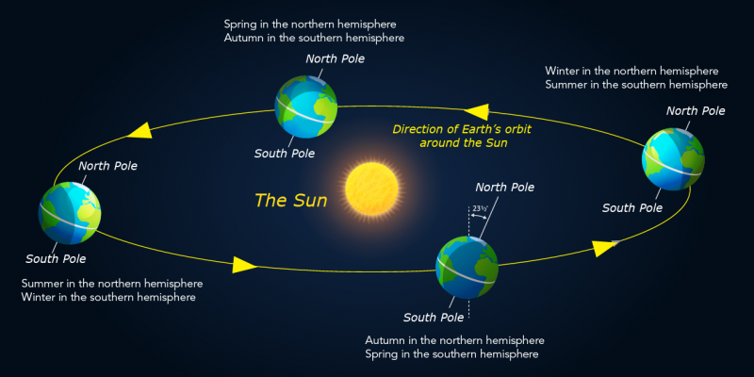
Reason for seasons:

Slide 18

What happens if we use 365 days?

Slide 19
What happens if we use 365 days?
Seasons go out of sync!

Slide 20
What happens if we use 365 days?

Slide 21

What happens if we use 365 days?
The extra 0.24 days throws seasons off after a few years!

Slide 22

What happens if we use 365 days?
Also, bad news for farmers!

Slide 23
How to solve this problem?

Slide 24
How to solve this problem?
Leap year!

Slide 25

How to solve this problem?
Leap year!
Egyptian astronomers around 50 B.C. measured the Earth’s orbit to be close to 365.25 days long.

Slide 26
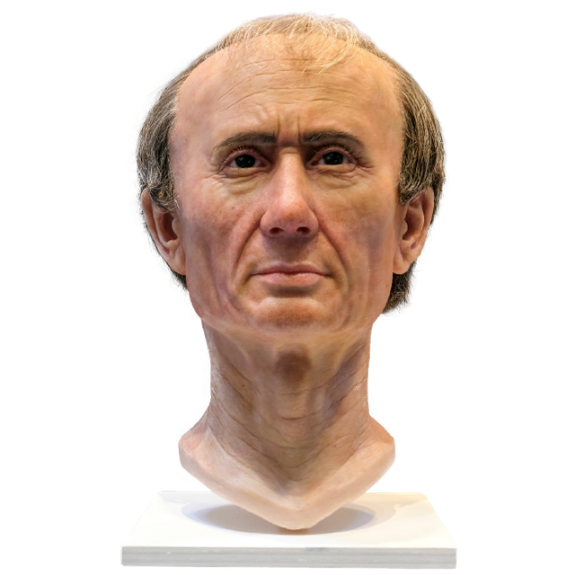
How to solve this problem?
Leap year!
Egyptian astronomers around 50 B.C. measured the Earth’s orbit to be close to 365.25 days long.
Julius Caesar implemented a new calendar in 46 B.C., adding one day every four years.

Slide 27
How to solve this problem?
Leap year!
Egyptian astronomers around 50 B.C. measured the Earth’s orbit to be close to 365.25 days long.
Julius Caesar implemented a new calendar in 46 B.C., adding one day every four years.
Essentially adding it to the last month of the leap year.

Slide 28
How to solve this problem?
Leap year!
Egyptian astronomers around 50 B.C. measured the Earth’s orbit to be close to 365.25 days long.
Julius Caesar implemented a new calendar in 46 B.C., adding one day every four years.
Essentially adding it to the last month of the leap year.
He also did a bunch of crazy stuff..

Slide 29

What else did Caesar do?

Slide 30
What else did Caesar do?
He shifted the beginning of the year from March 1 to January 1!

Slide 31
What else did Caesar do?
He also shifted the beginning of the year from March 1 to January 1!
That’s why the 7th month (September) through the 10th month (December) are now the 9th through 12th months.

Slide 32
What else did Caesar do?
He also shifted the beginning of the year from March 1 to January 1!
That’s why the 7th month (September) through the 10th month (December) are now the 9th through 12th months.
February, the ‘original’ 12th month, now gets to be the 2nd, and that’s the reason why we have the leap day this month.

Slide 33
Problem solved?

Slide 34

Problem solved?

Slide 35

Acshually..

Slide 36
Acshually..
Caesar’s solution overcorrects.

Slide 37

Acshually..
Caesar’s solution overcorrects.
The tropical year is different from a calendar year by 5 hours, 48 minutes, and 46 seconds.

Slide 38
Acshually..
Caesar’s solution overcorrects.
The tropical year is different from a calendar year by 5 hours, 48 minutes, and 46 seconds.
Over four years, that adds up to 23 hours, 15 minutes, and 4 seconds.

Slide 39
Acshually..
Caesar’s solution overcorrects.
The tropical year is different from a calendar year by 5 hours, 48 minutes, and 46 seconds.
Over four years, that adds up to 23 hours, 15 minutes, and 4 seconds.
That’s 44 minutes, 56 seconds less than a day.

Slide 40
Acshually..
Caesar’s solution overcorrects.
The tropical year is different from a calendar year by 5 hours, 48 minutes, and 46 seconds.
Over four years, that adds up to 23 hours, 15 minutes, and 4 seconds.
That’s 44 minutes, 56 seconds less than a day.
This adds about 3.12 days every 400 years.

Slide 41
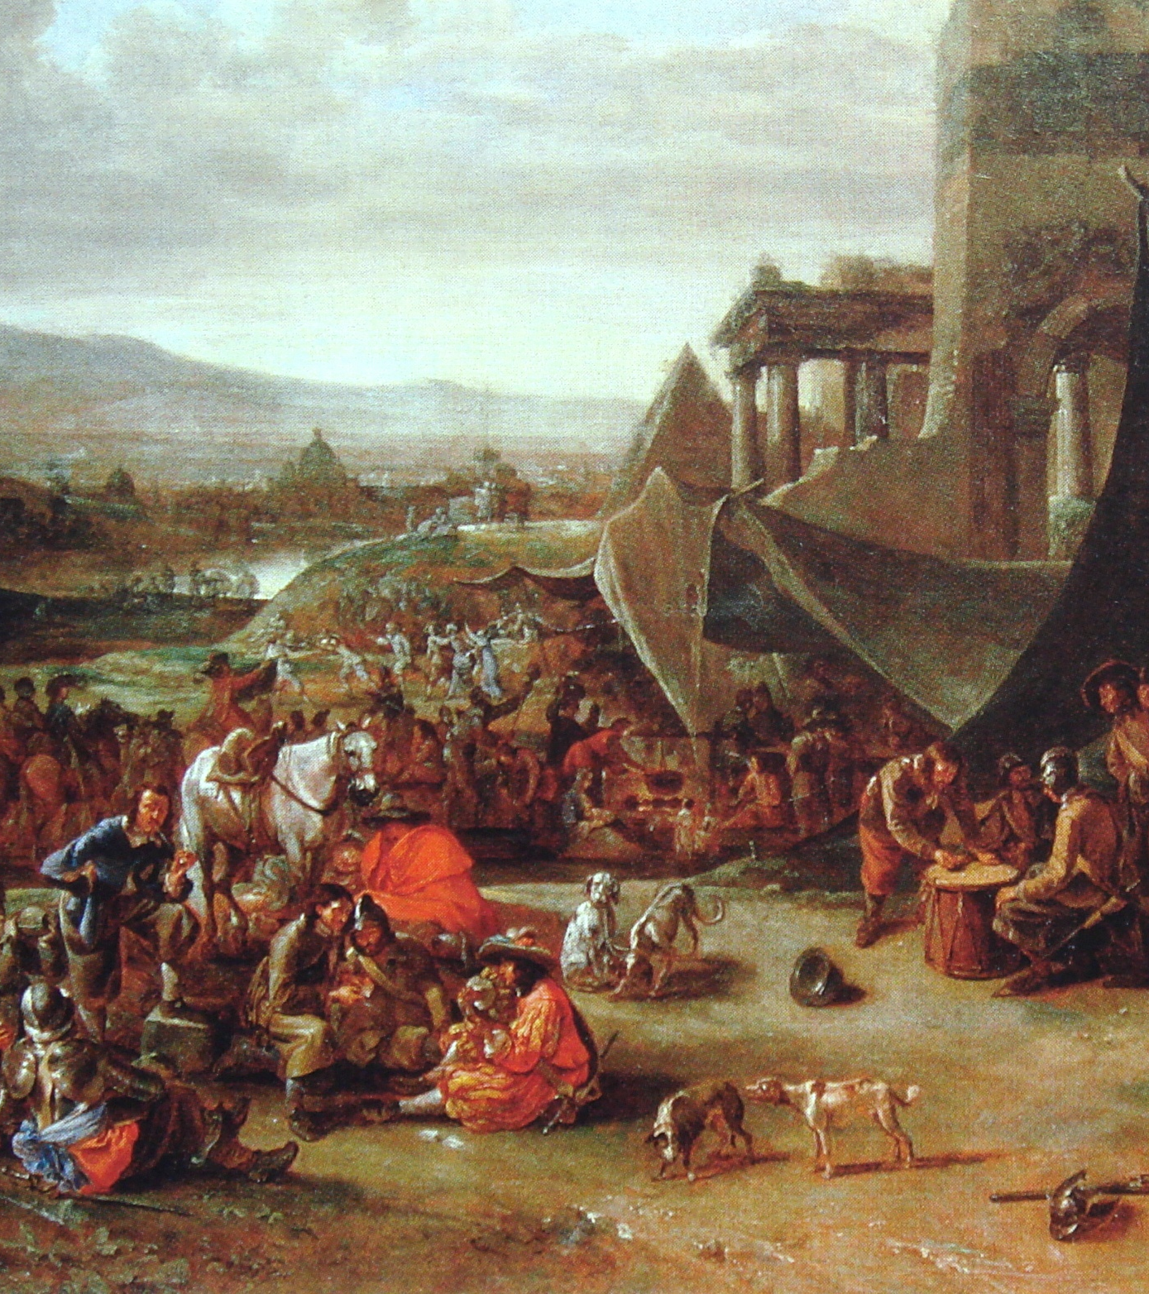
Cut to late 1500s..

Slide 42

Cut to late 1500s..
By 1582 A.D., this added up to 12.7 days, pushing spring towards winter.

Slide 43

Cut to late 1500s..
By 1582 A.D., this added up to 12.7 days, pushing spring towards winter.
The Catholic Church did not want to celebrate Easter in winter.

Slide 44


Cut to late 1500s..
By 1582 A.D., this added up to 12.7 days, pushing spring towards winter.
The Catholic Church did not want to celebrate Easter in winter.

Slide 45
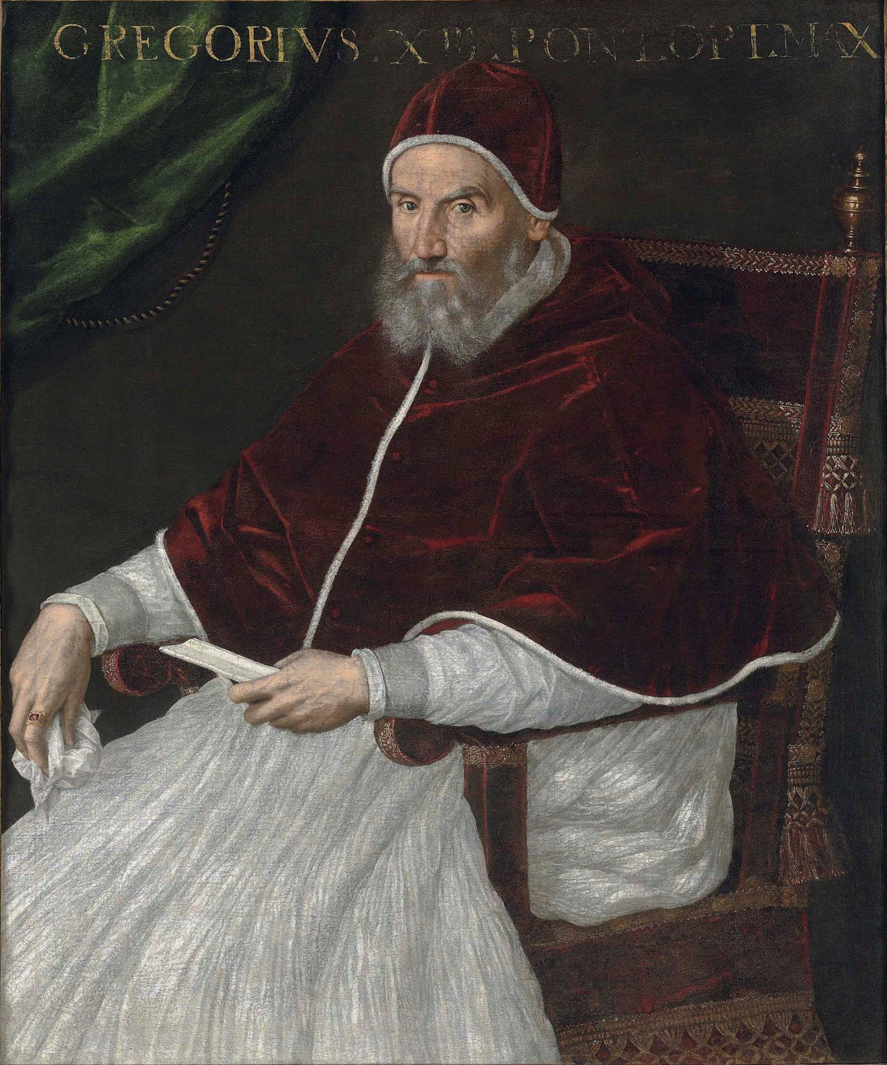
Cut to late 1500s..
By 1582 A.D., this added up to 12.7 days, pushing spring towards winter.
The Catholic Church did not want to celebrate Easter in winter.
Pope Gregory XIII decreed a new calendar in October that year.

Slide 46

Cut to late 1500s..
By 1582 A.D., this added up to 12.7 days, pushing spring towards winter.
The Catholic Church did not want to celebrate Easter in winter.
Pope Gregory XIII decreed a new calendar in October that year.
But at what cost?

Slide 47
New era begins..

Slide 48
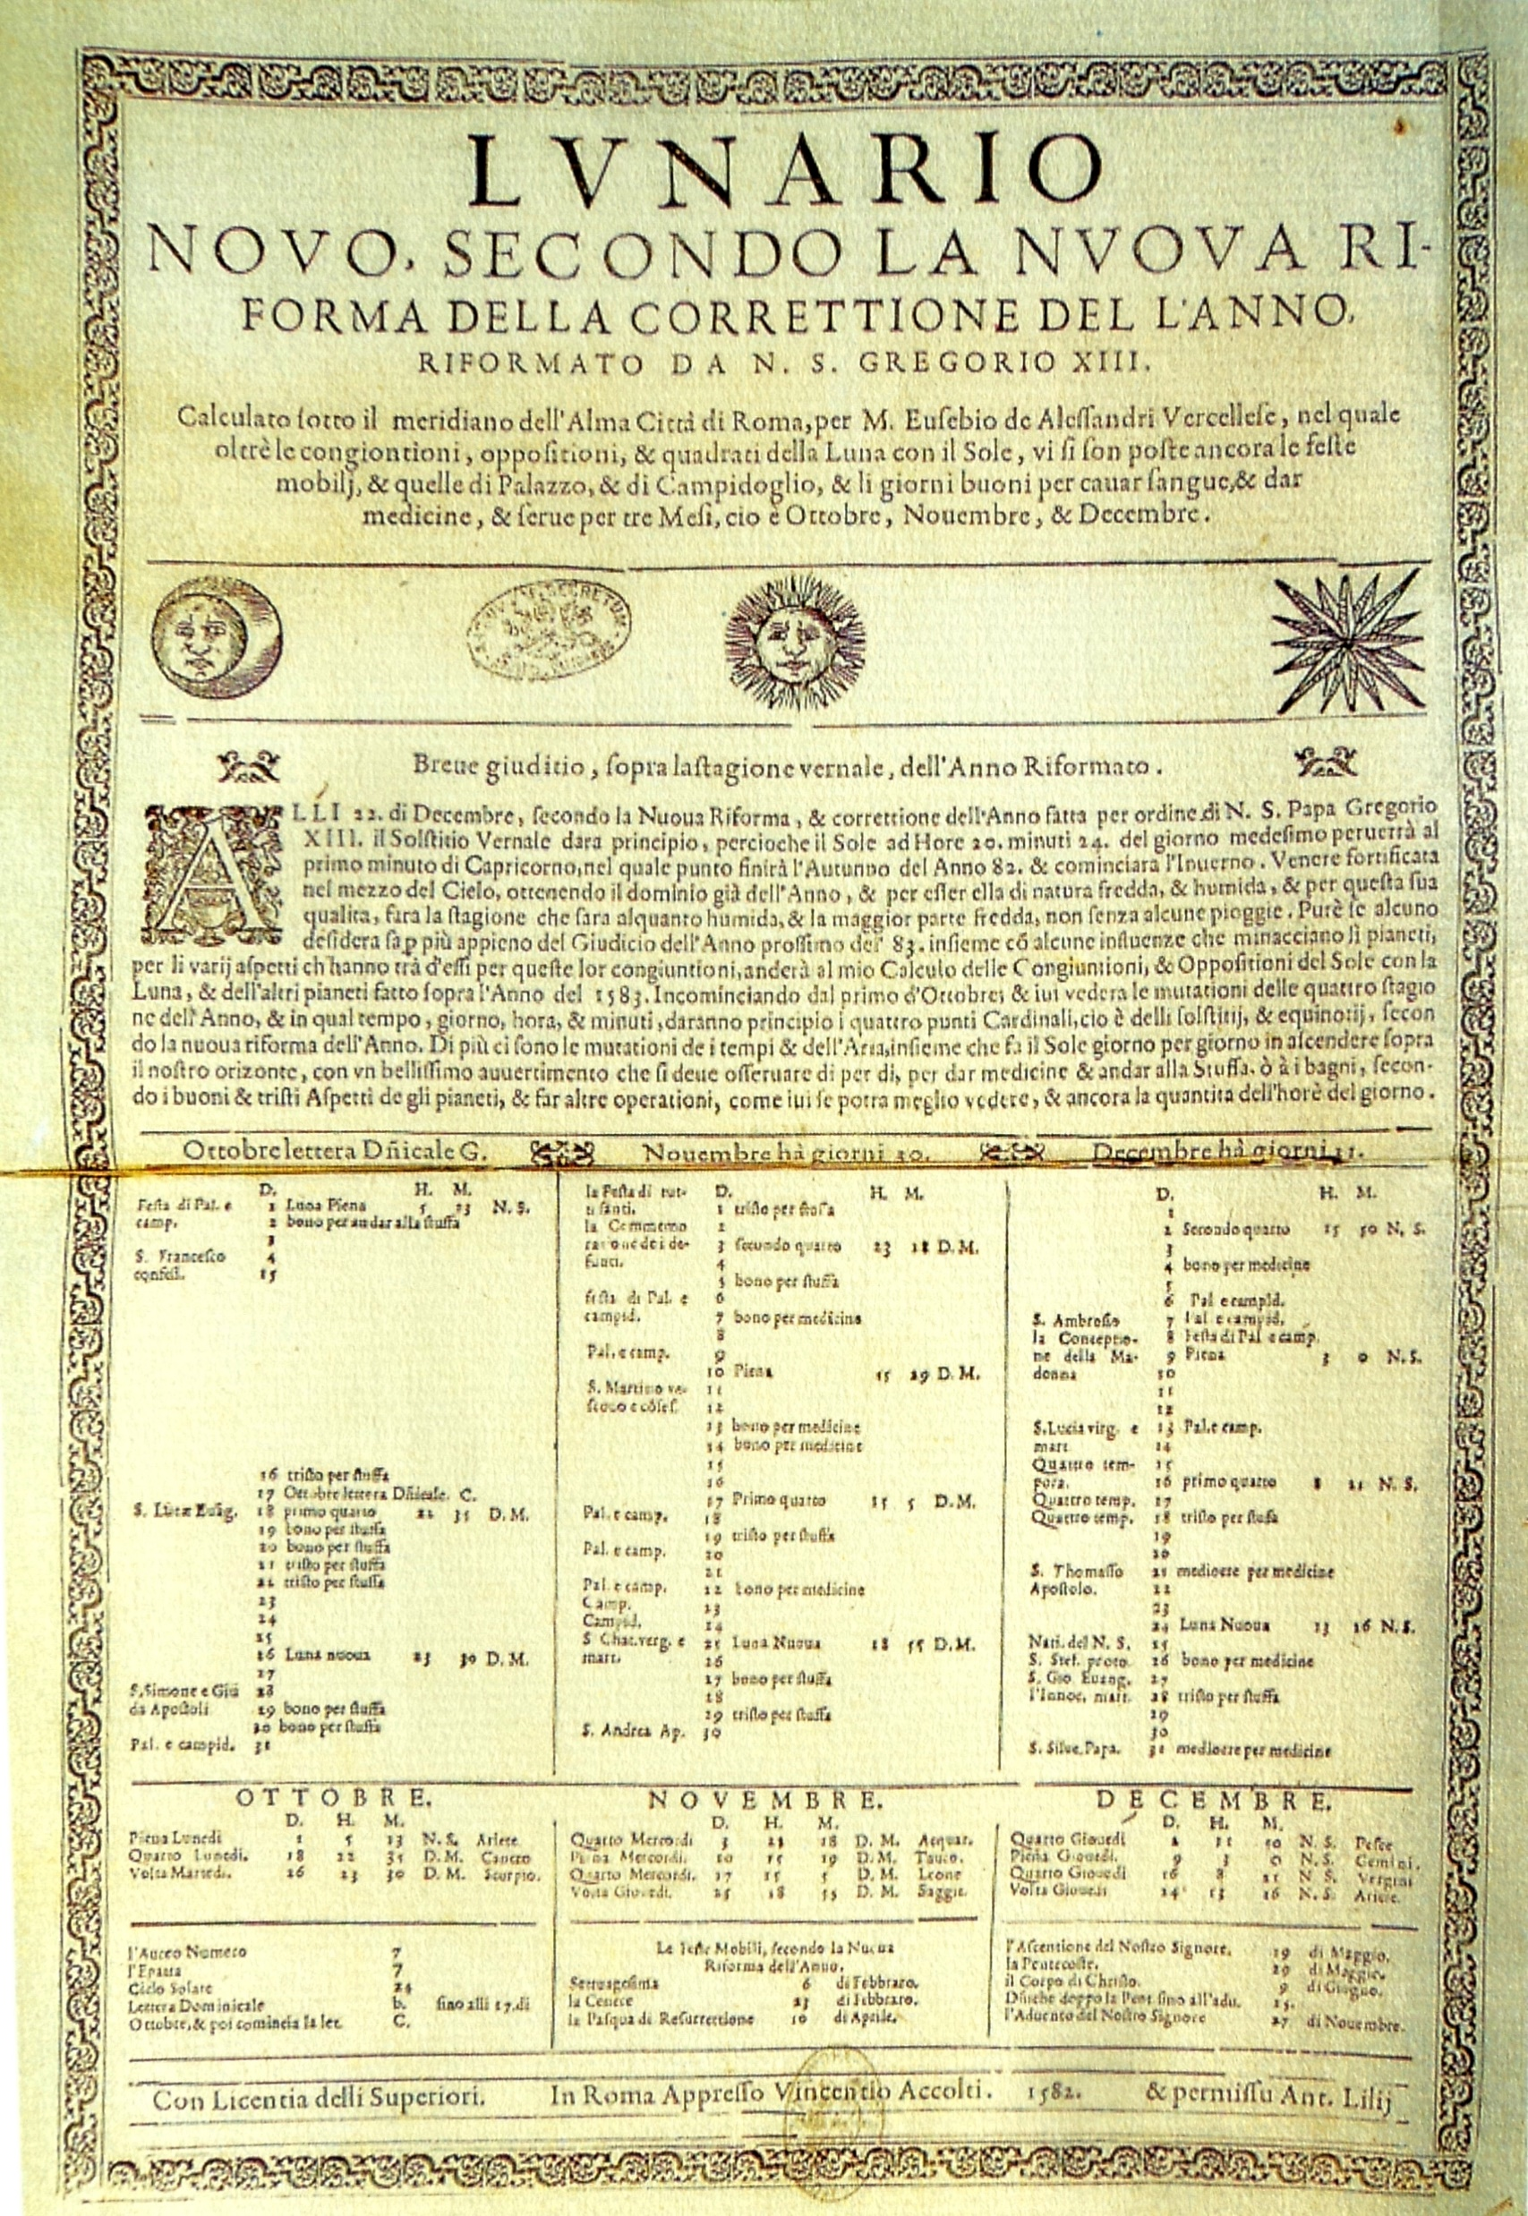
New era begins..
Thursday, 4 October 1582, was followed by Friday, 15 October 1582, with ten days skipped.

Slide 49
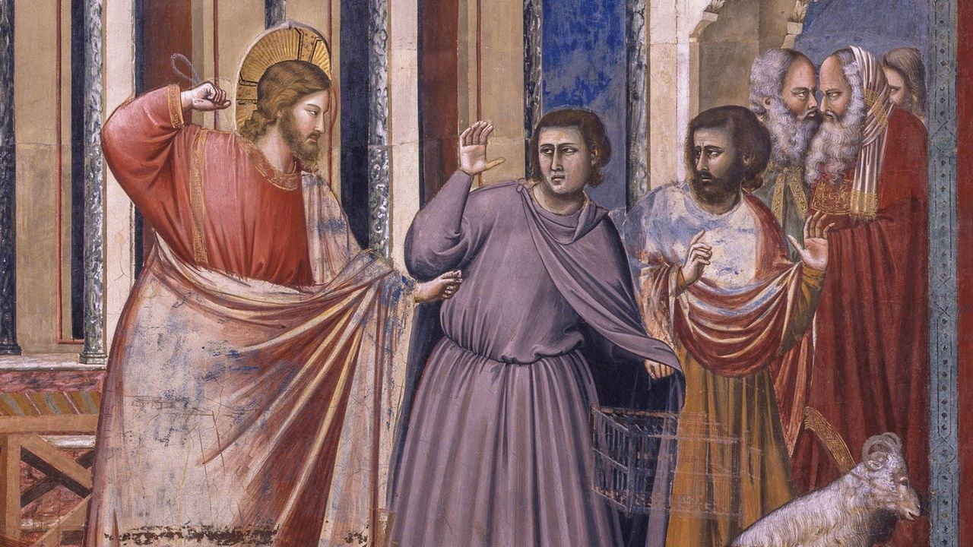
New era begins..
Thursday, 4 October 1582, was followed by Friday, 15 October 1582, with ten days skipped.
Understandably, people were pissed.

Slide 50
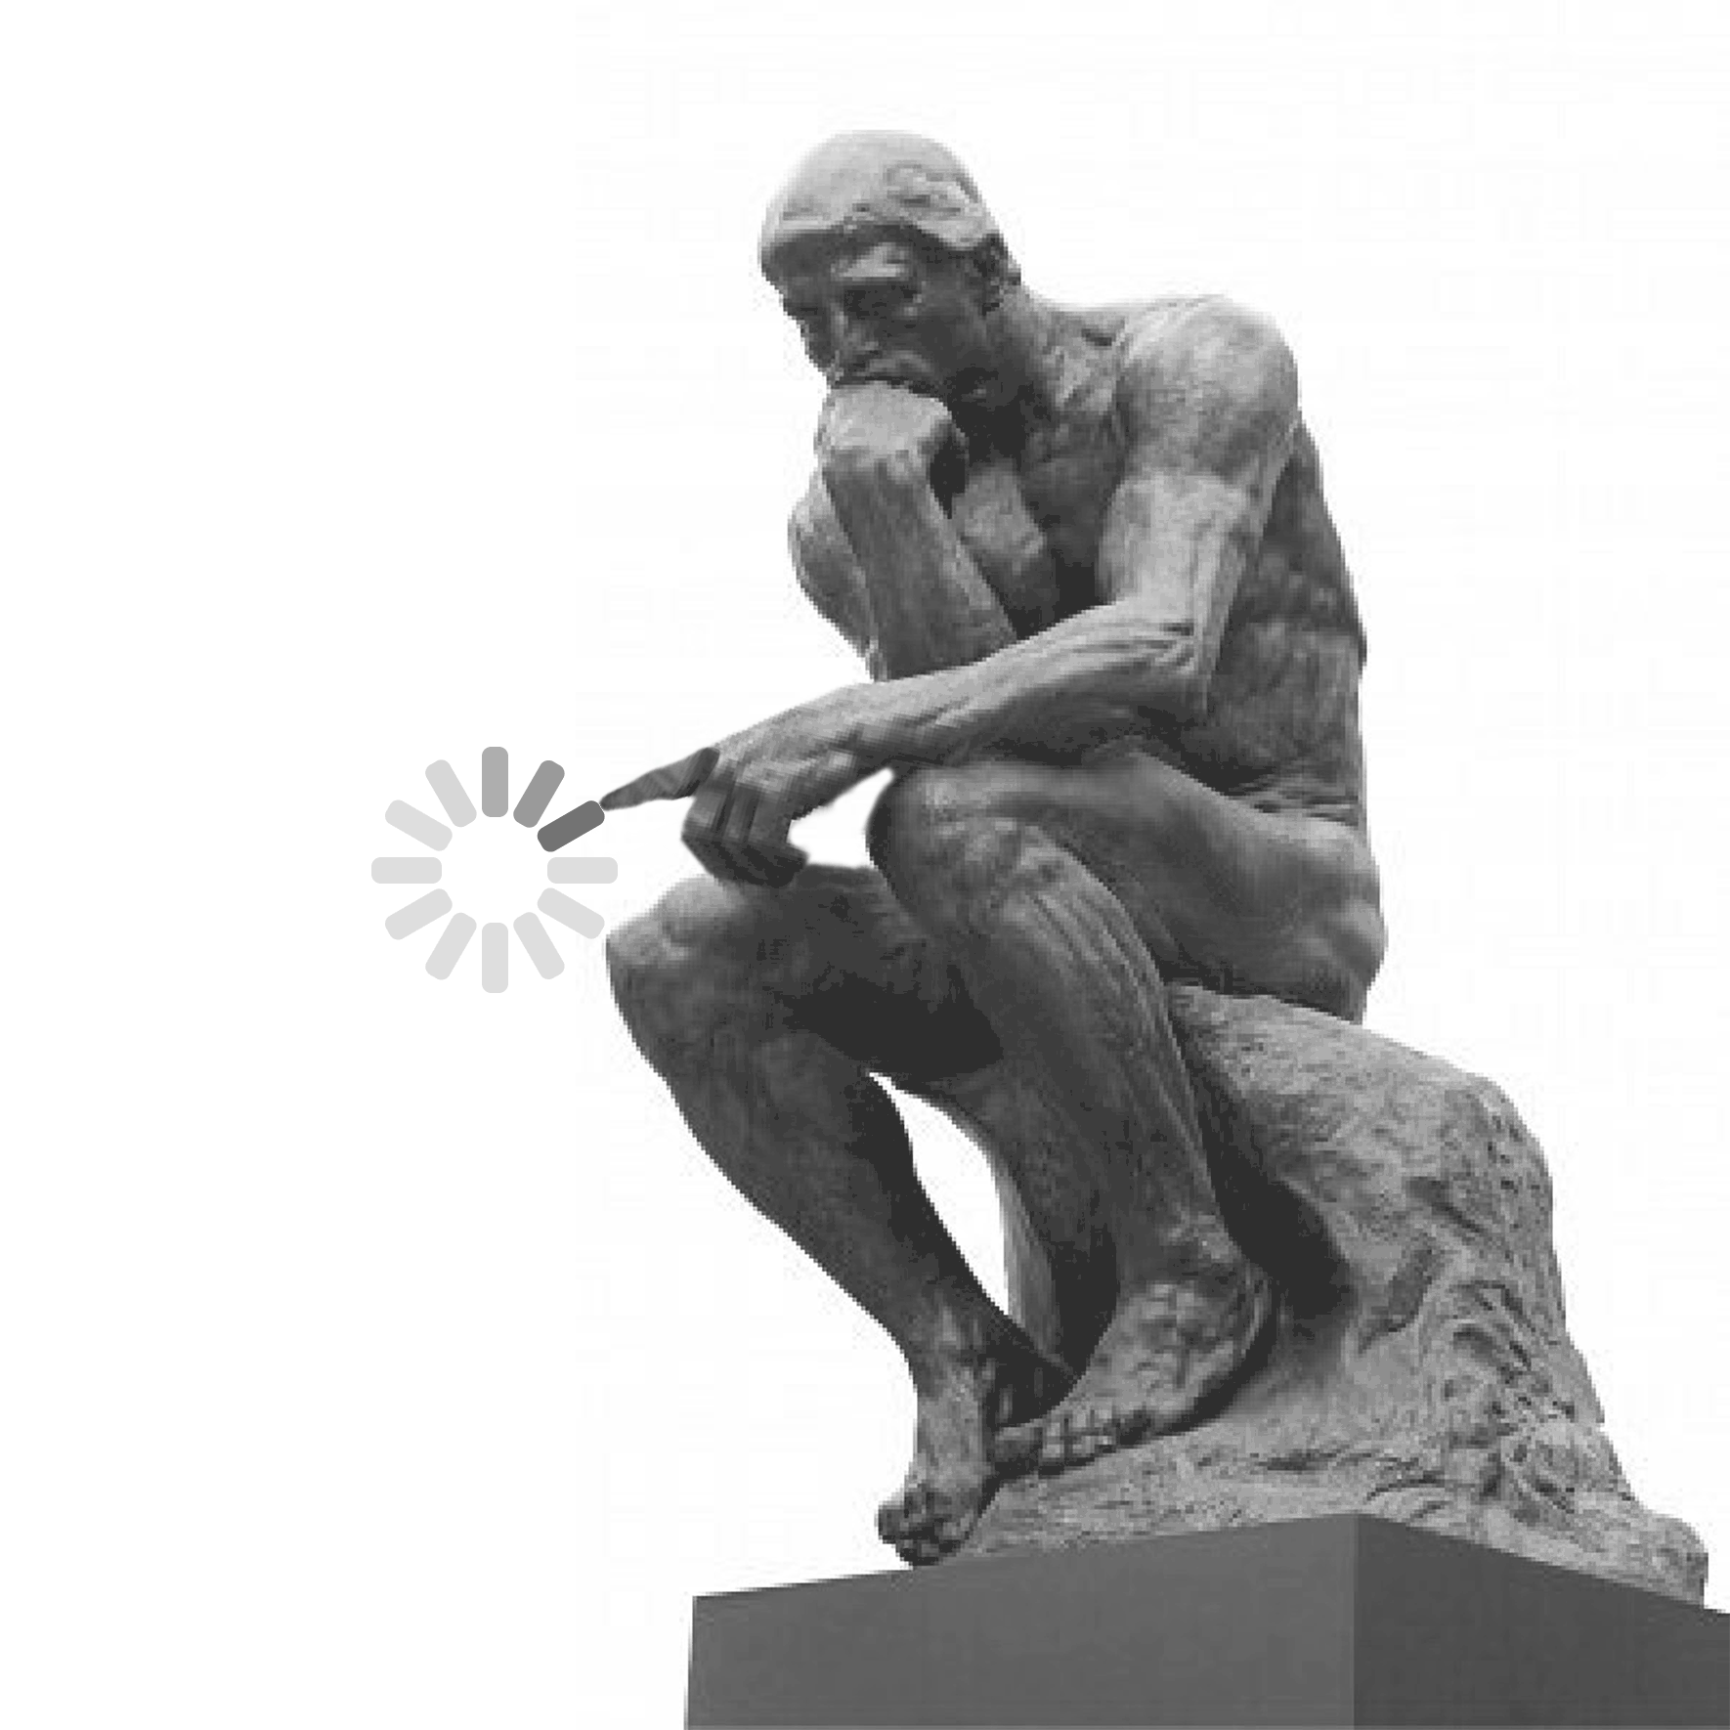
New era begins..
Thursday, 4 October 1582, was followed by Friday, 15 October 1582, with ten days skipped.
Understandably, people were pissed.
But the problem of overcorrection persists.

Slide 51
New era begins..
Thursday, 4 October 1582, was followed by Friday, 15 October 1582, with ten days skipped.
Understandably, people were pissed.
But the problem of overcorrection persists.
How do we correct that?

Slide 52
New formula:

Slide 53
New formula:
Remember the 3.12 days added every 400 years?

Slide 54


New formula:
Remember the 3.12 days added every 400 years?
Rinse and repeat the same trick!

Slide 55
New formula:
Remember the 3.12 days added every 400 years?
Rinse and repeat the same trick!
They designated only certain hundred-year dates as leap years.

Slide 56
New formula:
Remember the 3.12 days added every 400 years?
Rinse and repeat the same trick!
They designated only certain hundred-year dates as leap years.
Only hundred-year dates such as 1600, 2000, etc. which are divisible by 400 are leap years.

Slide 57
New formula:
Remember the 3.12 days added every 400 years?
Rinse and repeat the same trick!
They designated only certain hundred-year dates as leap years.
Only hundred-year dates such as 1600, 2000, etc. which are divisible by 400 are leap years.
Others, such as 1700, 1800, 1900, 2100, etc. are not!

Slide 58
Is it perfect?

Slide 59

Is it perfect?
Not really; but will work for a long time ~ 3333.3 years.

Slide 60
More math! Why 3333.3 years?

Slide 61

More math! Why 3333.3 years?

Slide 62
Anyway..
In 1200 years, we should have 1200/4 = 300 leap years.

Slide 63

Anyway..
In 1200 years, we should have 1200/4 = 300 leap years.
But only 3 century-years (out of 12) are divisible by 400; i.e., {400, 800, 1200}, {1600, 2000, 2400}, etc.

Slide 64

Anyway..
In 1200 years, we should have 1200/4 = 300 leap years.
But only 3 century-years (out of 12) are divisible by 400; i.e., {400, 800, 1200}, {1600, 2000, 2400}, etc.
12–3 = 9, so we actually have 300-9 = 291 leap years. And 1200-291 = 909 regular years.

Slide 65

Anyway..
In 1200 years, we should have 1200/4 = 300 leap years.
But only 3 century-years (out of 12) are divisible by 400; i.e., {400, 800, 1200}, {1600, 2000, 2400}, etc.
12–3 = 9, so we actually have 300-9 = 291 leap years. And 1200-291 = 909 regular years.
The average length of year becomes (291 x 366 + 909 x 365)/1,200 = 365.2425 days.

Slide 66

Anyway..
In 1200 years, we should have 1200/4 = 300 leap years.
But only 3 century-years (out of 12) are divisible by 400; i.e., {400, 800, 1200}, {1600, 2000, 2400}, etc.
12–3 = 9, so we actually have 300-9 = 291 leap years. And 1200-291 = 909 regular years.
The average length of year becomes (291 x 366 + 909 x 365)/1,200 = 365.2425 days.
This gives an error of 365.2425 - 365.2422 = 0.0003 days per year, or one day every 3,333.3 years.

Slide 67
What next?

Slide 68
What next?
Earth’s rotation and revolution are changing constantly.

Slide 69

What next?
Earth’s rotation and revolution are changing constantly.
Therefore, we will need new calculations to correct for those changes.

Slide 70
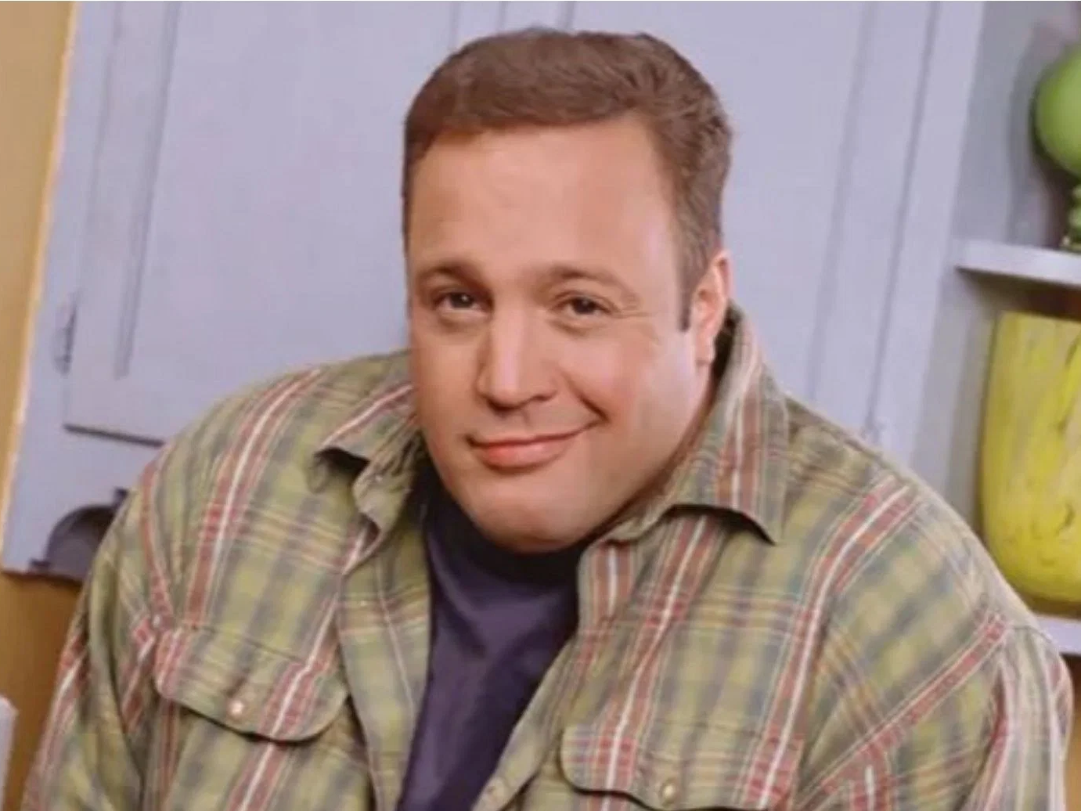
What next?
Earth’s rotation and revolution are changing constantly.
Therefore, we will need new calculations to correct for those changes.
Current astronomers don’t really care, it is up to the future astronomers to figure it out.

Slide 71

Questions?

Slide 72
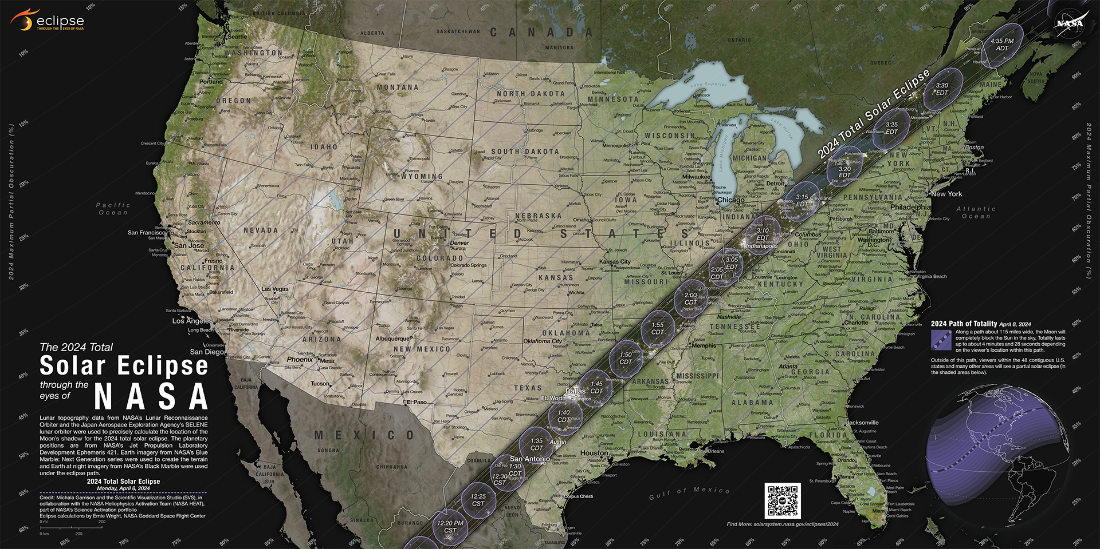

April 8th Eclipse: ~94% in Columbia
Info from NASA:

Slide 73



Follow Laws Observatory:

Slide 74





Thank you!
Teja Teppala
ttgbk@mail.missouri.edu

Slide 75
How did Egyptian astronomers figure the length of Earth’s orbit?
Egyptians started out with a lunar calendar, based on Moon’s phases.
It was around 354 days long (loss of 11 days).
Around 2500 B.C., they adopted a new “civil” calendar based upon astronomical observations of Sirius.
Sirius appeared right before sunrise around the onset of Nile’s flood.

Slide 76
How did Egyptian astronomers figure the length of Earth’s orbit?
They tried to correct it based on Sirius’ reappearance during the next flooding.
This ended up in a calendar year of 365 days; 12 months of 30 days each and a “13th month” of 5 days.
Over time, they realized that Sirius rose a day late every 4 years.
Thus, they figured that the actual year is a quarter day longer than 365 days.

